Slide 1


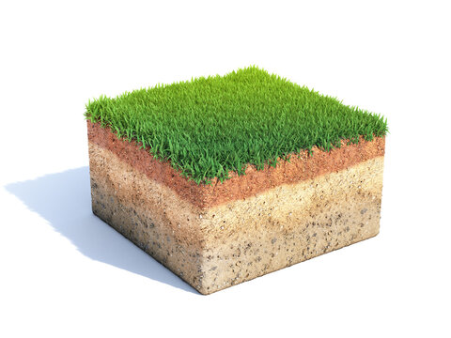
PROBLEM
What’s the altitude and Pressure?
What’s the temperature?
How moist is the soil?

Slide 2

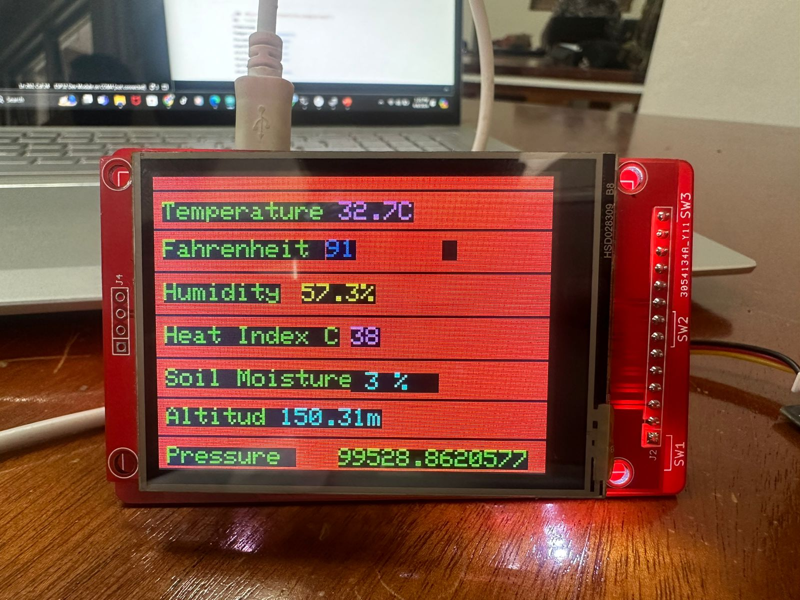

Slide 3

ACCURATE TIME DISPLAY
What can
Prime Weather Station
do?
12HR AND 24HR FORMAT
ALARM

Slide 4
Display Temperature, Humidity, Heat Index, Altitude, Pressure, & Soil Moisture (Hardware)
What can
Prime Weather Station
do?
12HR AND 24HR FORMAT
ALARM

Slide 5
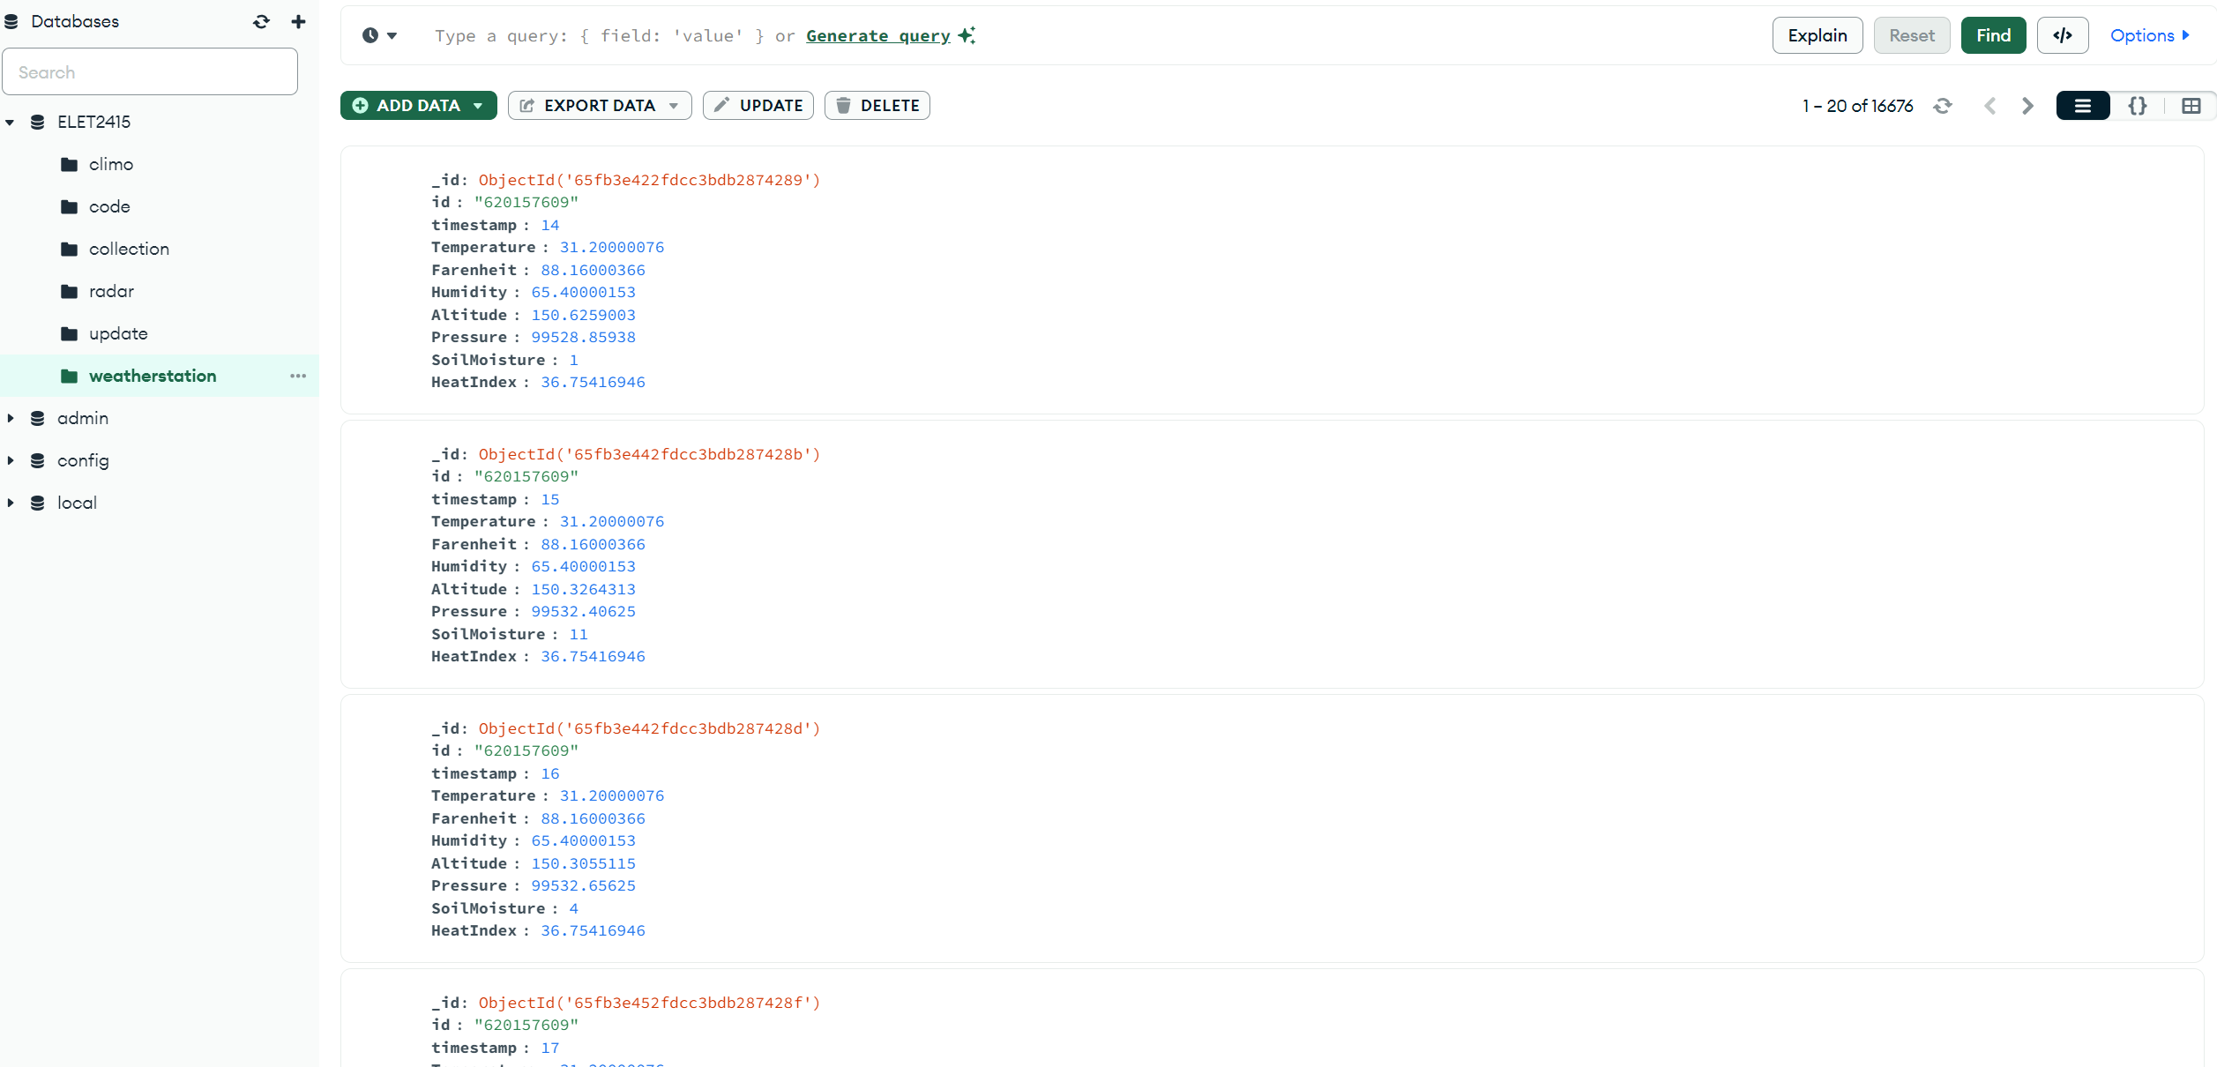
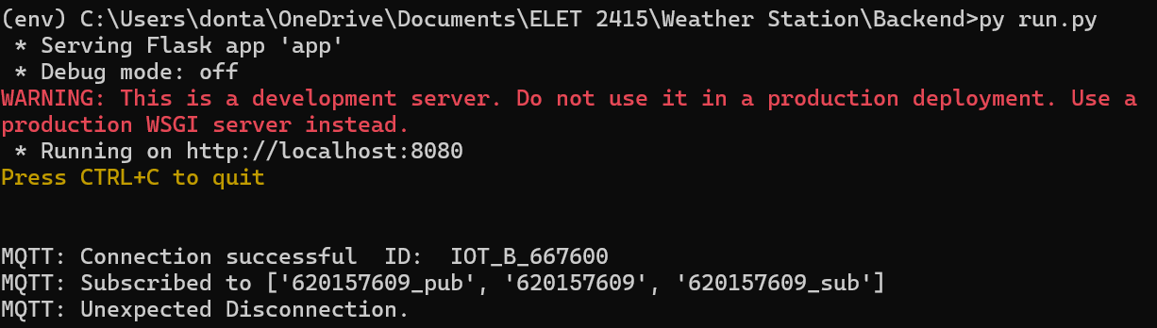
ACCURATE TIME DISPLAY
What can
Prime Weather Station
do?
Publish and store data in an online database for viewing. (Backend)
ALARM

Slide 6
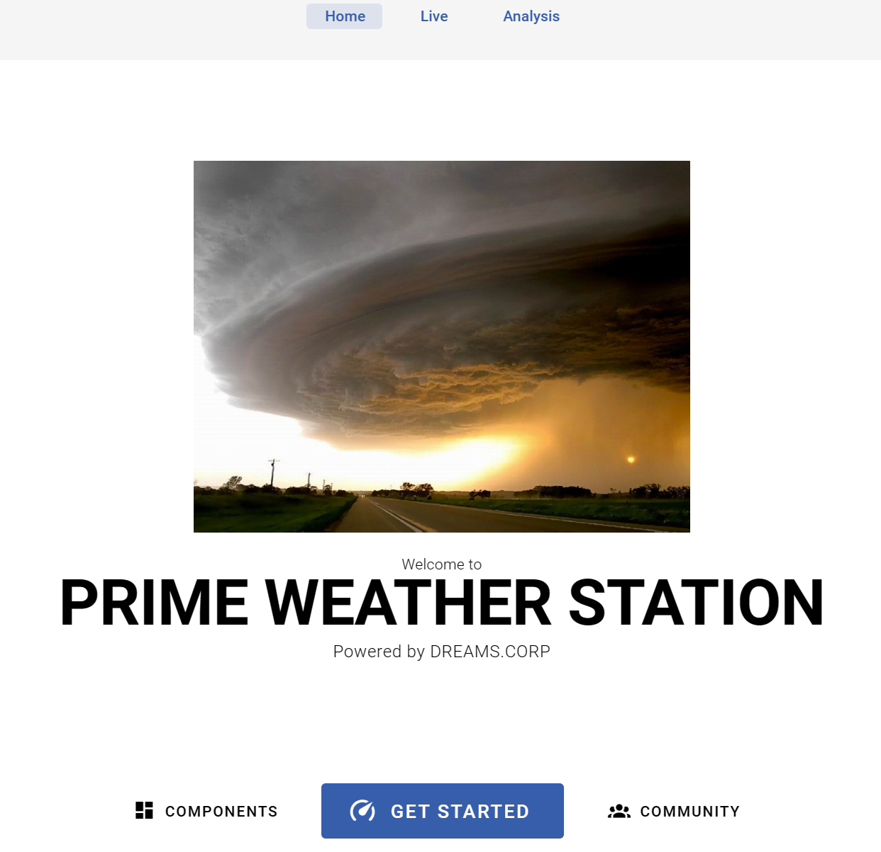
ACCURATE TIME DISPLAY
What can
Prime Weather Station
do?
12HR AND 24HR FORMAT
GUI that retrieves information from the online database and presents it on the webpage. (Frontend)

Slide 7
Internet of Things
The Internet of Things, or IoT, is a network of physical devices. These devices are inter-connected and they can transfer data to one another without human intervention. The Internet of Things connects the physical and digital realms using a range of technologies. Physical objects are embedded with sensors—which can monitor things like motion, temperature, humidity, or any change in environment—and actuators—which receive signals from sensors and then do something in response to those changes. The devices communicate via wired (for example, Ethernet) or wireless (for example, WiFi or cellular) networks.

Slide 8
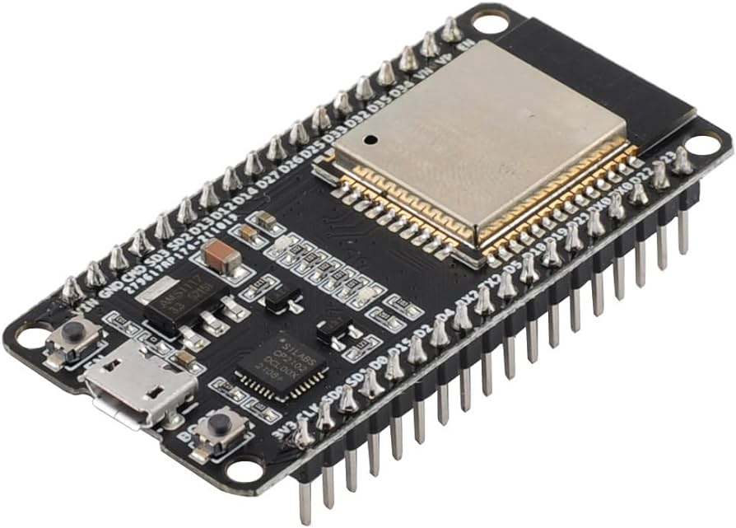


Internet
of
Things

Slide 9
Hardware
The hardware side of an IoT system is all about the physical devices and their inner workings. It all starts with sensors that gather data like temperature or motion. A tiny computer called a microcontroller then crunches those numbers. Connectivity modules like Wi-Fi or Bluetooth get the data out to the internet. Finally, some devices have actuators that can take action based on the data, like smart locks or valves. Depending on the specific device, there might be additional hardware like GPS or a display screen. All this hardware works together to bring the smarts to everyday objects.
Temperature: DHT22 Sensor
Pressure and Altitude: BMP 280 Pressure Sensor
Soil Moisture: Capacitive Soil Moisture Sensor
Internet
of
Things

Slide 10
Backend
The core of this system lies in the backend, which utilizes a combination of three powerful tools. First, the Message Queuing Telemetry Transport (MQTT) acts as a communication hub. Devices publish sensor data, and the MQTT broker, Mosquitto, securely manages this data, ensuring only authorized devices can publish and only interested parties can receive it. Our ESP32 device leverages MQTT to publish meteorological data. Next, Node.js, a versatile JavaScript runtime environment, plays a crucial role. It subscribes to the relevant MQTT topic, processes the incoming sensor data, and formats it appropriately. Finally, MongoDB, a document-based database, serves as the storage solution. The formatted data is stored in JSON-like documents within MongoDB, readily accessible for further analysis and visualization. In essence, this backend seamlessly collects data, processes it, and stores it for future use.
Internet
of
Things

Slide 11
Frontend
The front end of an IoT system is all about user interaction. It's the stage where the collected data is transformed into a user-friendly format, allowing users to visualize trends, monitor devices, and interact with the system. Imagine a user-friendly mobile app displaying real-time temperature readings from your smart thermostat or a web interface showcasing energy consumption patterns. These interfaces, built with technologies like web frameworks or UI toolkits, are the bridge between the complex backend and the human user. They present the data clearly and concisely, enabling users to make informed decisions and control their connected devices with ease. In short, the front end breathes life into the data, making the power of IoT accessible and user-friendly.
Internet
of
Things

Slide 12
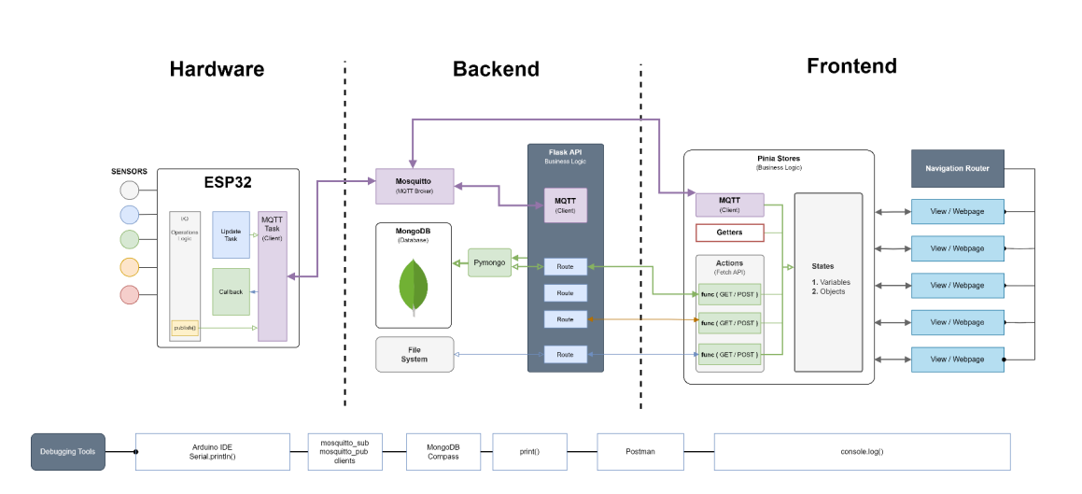

Slide 13
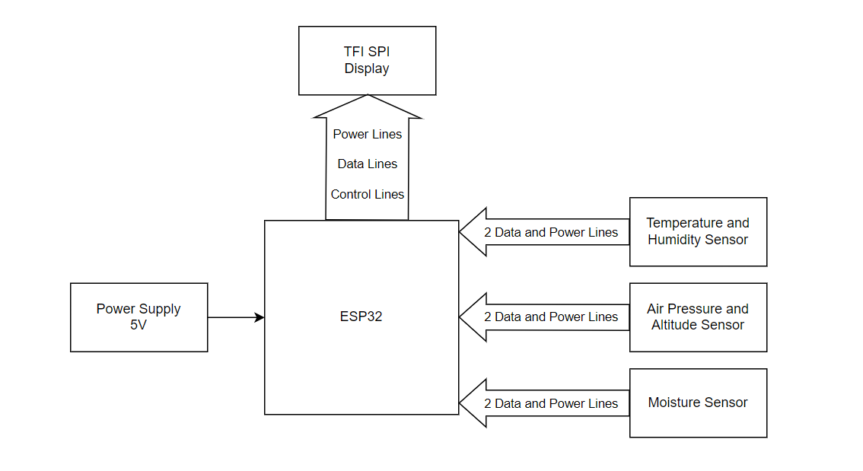
BLOCK DIAGRAM

Slide 14
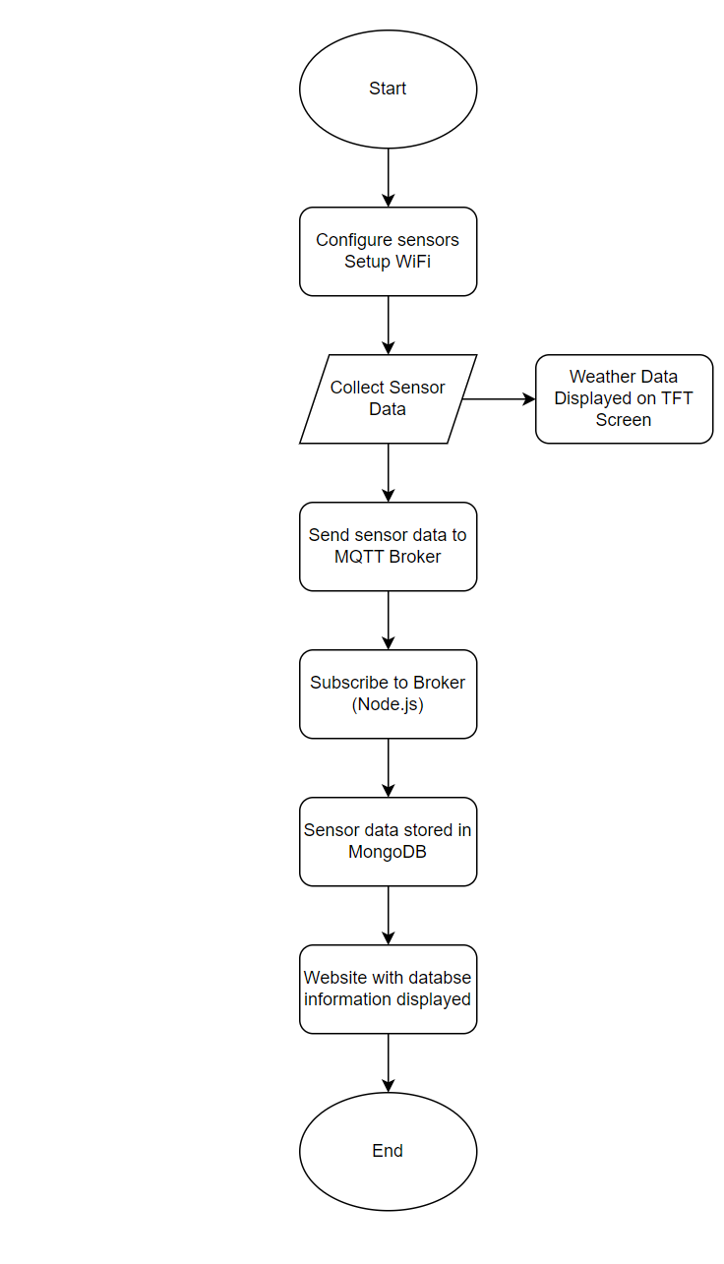
FLOW CHART

Slide 15

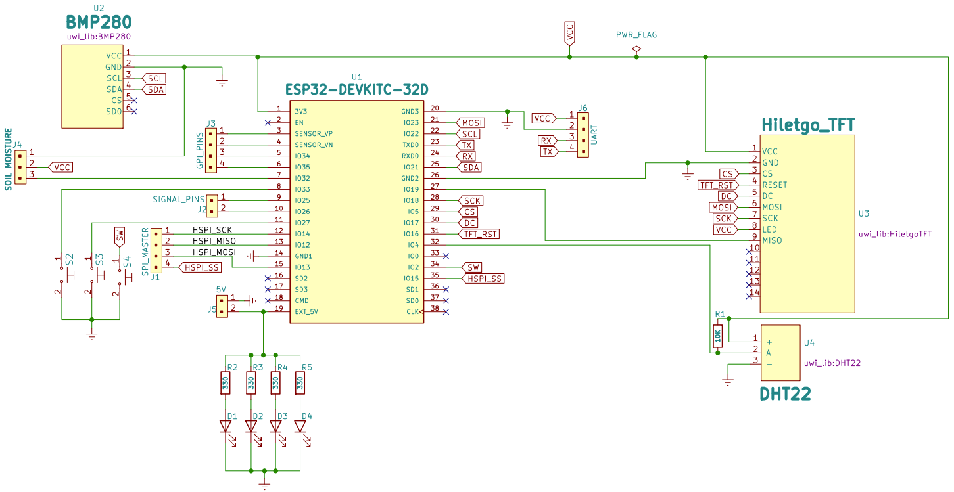
DEVELOPMENT PERIOD

Slide 16
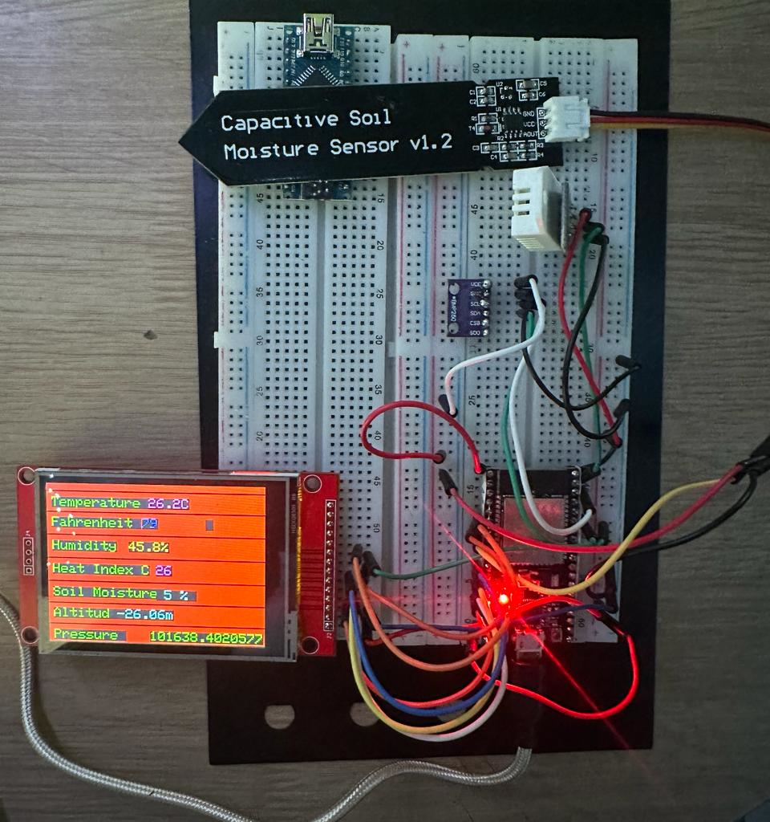
Bread Board

Slide 17
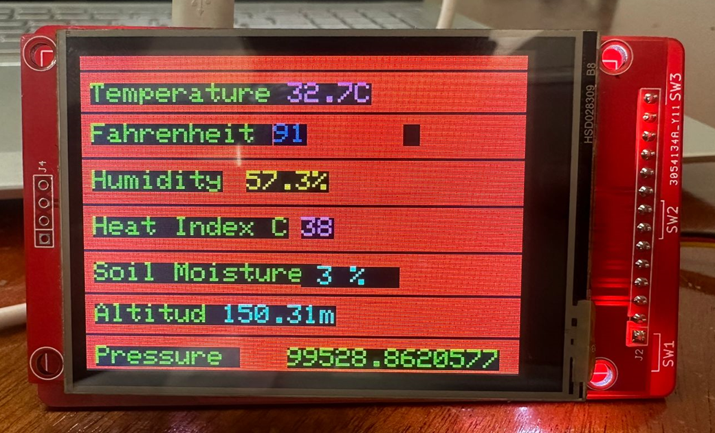
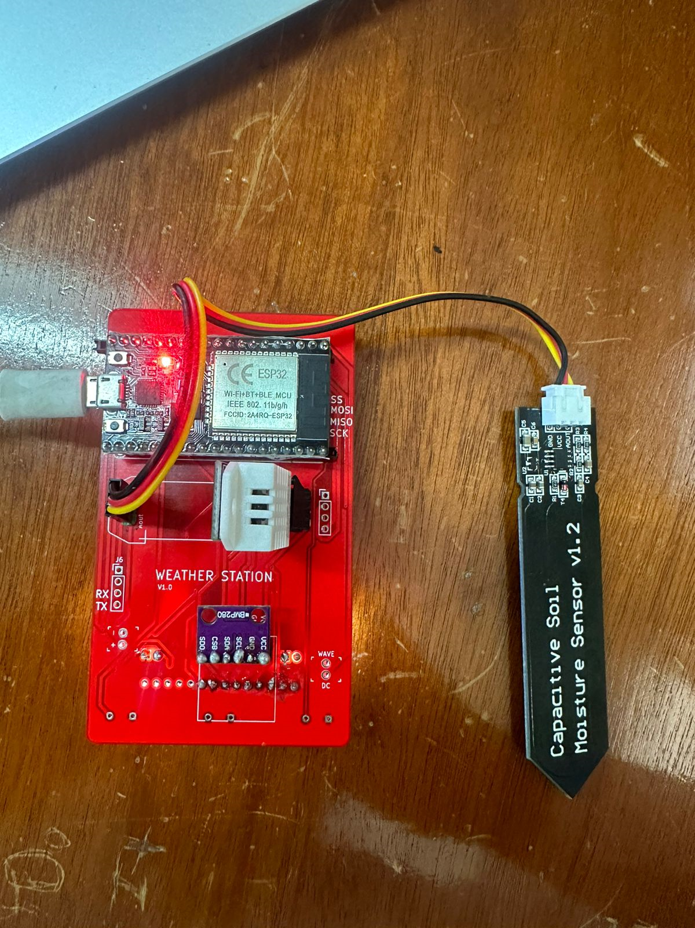
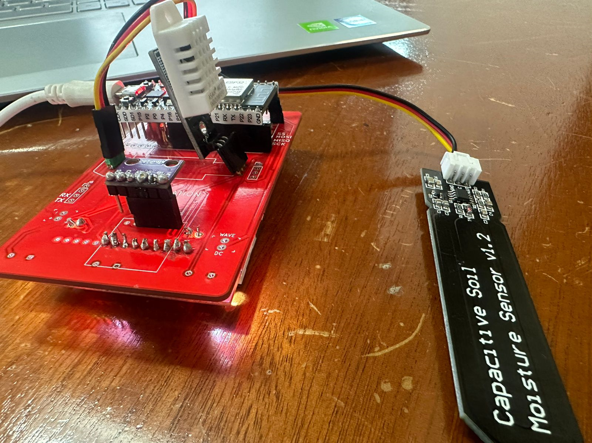

Slide 18
Components List and Price
Components
ESP32 Microcontroller- $2,200.00
Weather Station Blank PCB- $500.00
Soil Moisture Sensor- $1,200.00
DHT22 Humidity Sensor- $1,200.00
BMP 280 Pressure Sensor- $850.00
2.8” TFT Display Module- $3,200.00
10k ohm Resistor- $100.00
4 220 ohm Resistors- $200.00
4 LED- $350.00
Total: $10,000 (Approx.)
Equipment
Computer with the latest version of:
Microsoft VS Code Editor
Postman
KiCad Suite
Arduino IDE
Eclipse Mosquitto MQTT Broker
Node.js JavaScript Engine
MongoDB Database Micro USB Cable

Slide 19

THE END

Slide 20
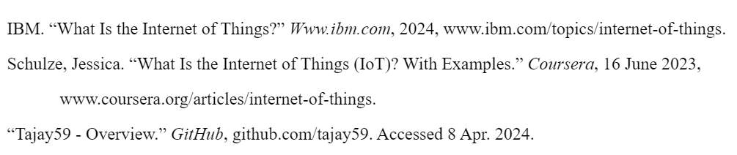
Reference

